Slide 1
NETFLIX STOCK PRICE ANALYSIS FOR 2017
CODECADEMY CAPSTONE PROJECT
JANUARY 2020
@cnucup

Slide 2
Visualization List
- Distribution of 2017 Netflix Stock Prices by Quarter
- Earnings Per Share in Cents
- Revenue vs. Earnings
- Comparison of Netflix and DJI Performances
@cnucup

Slide 3
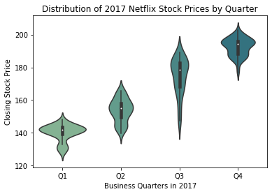
Distribution of 2017 Netflix Stock Prices by Quarter
- Netflix stock price has increased each quarter during 2017.
- The lowest price was a little bit higher than $120 and the highest price was around $210 for the same period.
@cnucup

Slide 4
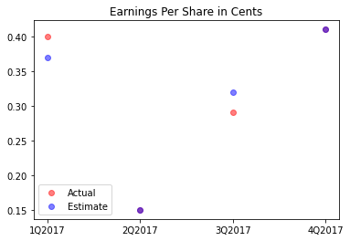
Earnings Per Share in Cents
- In the second and the fourth quarters, actual and estimate earning points overlap indicating that the estimations for these quarters were accurate.
- Netflix stock performed poorly in the third quarter comparing to the expectation.
@cnucup

Slide 5
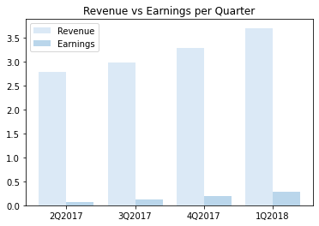
Revenue vs. Earnings
- Both revenue and earnings increased each quarter during 2017.
- Percentage of the earnings in revenue has increased from 2% to 8%.
@cnucup

Slide 6
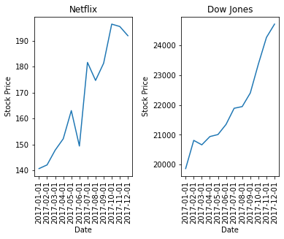
Comparison of Netflix and DJI Performances
- Netflix stock price has increased 37% in 2017 while Dow Jones Industrial Average stock price has increased 24%.
- However, Netflix stock price seemed to be more volatile with more fluctuations compared to DJI.
@cnucup

Slide 7
THANK YOU
@cnucup

